Slide 1


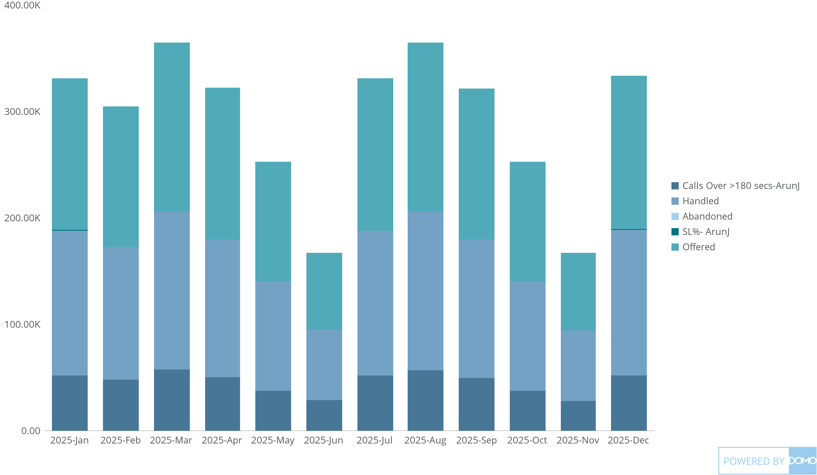
+
exported May 17, 2025, 12:32:00 PM UTC
PE 1 | CARD 5| MTD Performance(Offered VS Handled Vs SL)
This Year, by Month

